Slide 1
Earth’s Metamorphosis
A New Hypothesis for the Earth-Moon System
By Douglas B. Ettinger
Author of www.ettingerjournals.com
2014, Revision 1

Slide 2
A New Version of Earth-Moon’s Genesis is Added to NASA’s Existing Four Versions
Binary Model
Fission Model
Capture Model
Collision Model with Accretion – 4.5 bya
Metamorphosis with collision and capture modes – 3.9 bya

Slide 3
Timelines for Modern Ideas and Ages of Earth-Moon System
Radiometric dating-1930
Apollo Missions from 1961 to 1972
First publication of Giant Impact – 1975
Published analysis of Moon rocks isotopes similar to Earth’s – 2001
Proposed Impactors came from LaGrangian points – 2004 and 2011
Birth of solar sys.- 4.6 bya
Age of Moon-4.53 to 4.48 bya
Age of oldest Earth rocks – 4.28 to 3.8 bya.
Age of LHB and metamorphosis event 4.1 - 3.9 bya
Cooling of Moon’s mares – 4.0 to 3.16 bya
Life (RNA/DNA) begins on Earth – 3.8 to 3.2 bya with surface temp. 80°C to 70°C

Slide 4
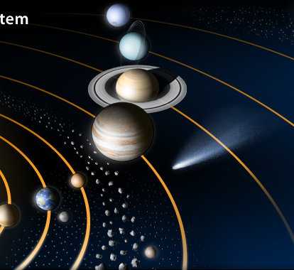
Today’s Solar System
Not shown is Pluto and other Kuiper Belt Objects (KBOs) beyond Neptune’s orbit. Much farther away is the suspected spherical Oort cloud of comets.

Slide 5
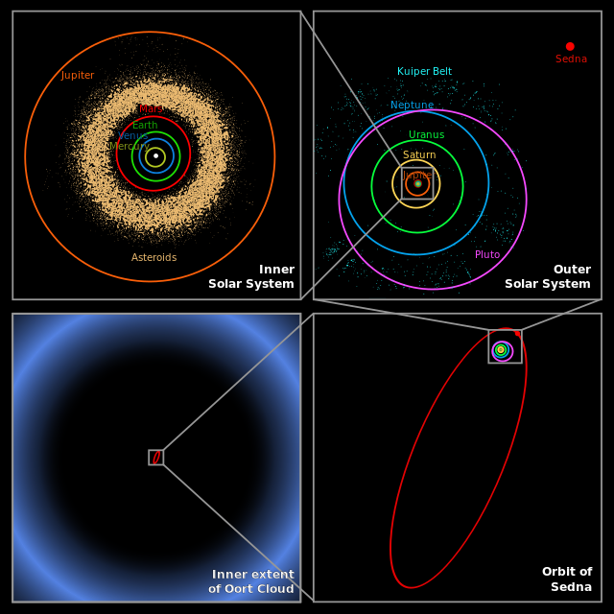
Scale of Solar System
Main belt of asteroids, outer planetary orbits, Sedna’s orbit (recently discovered KBO), and the postulated Oort cloud are shown to scale

Slide 6
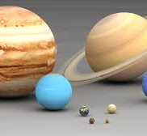
Planetary Sizes Shown to Scale
Jupiter and Saturn are the gas giants; Uranus and Neptune are the ice giants; Earth, Venus, Mars, and Mercury are the rocky inner terrestrial planets.

Slide 7
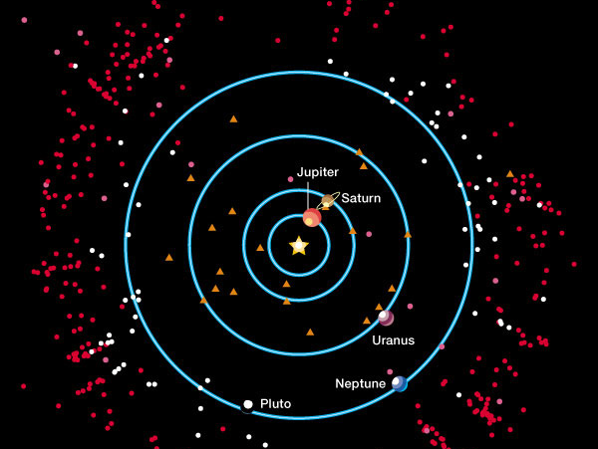
Outer Solar System Objects
Taken from Tegler and Romanishin’s photometric surveys
Kuiper
Belt
Objects
Plutinos
Scattered
Disk
Objects
Centaurs

Slide 8
Recent Objects Discovered in Outer Solar System
Kuiper belt objects (KBOs) are red circles beyond Neptune’s orbit
Plutinos are white circles with orbits similar to Pluto
Scattered disk objects (SDOs) are magenta circles mostly outside the ecliptic plane
Centaurs (considered icy comets) are orange triangles that have escaped Kuiper belt

Slide 9
Solar System Conundrums
What caused the Late Heavy Bombardment?
Why is the Earth-Moon system so very different from other planetary systems?
Why is the Moon more like a planet instead of a normal planetary satellite?
What caused the Main Belt of asteroids and the Kuiper Belt icy objects beyond Pluto?
What is the source and reason for comets that have both long and short period orbits?

Slide 10
“Nice model” tries to explain the Late Heavy Bombardment Period (LHB)
Simulation shows the outer planets and the Kuiper belt
  Before Jupiter–Saturn 2:1 resonance
  Scattering of Kuiper belt objects into the Solar System after the orbital shift of Neptune
  After ejection of Kuiper belt bodies by Jupiter. Planets shown: Jupiter (green circle), Saturn (orange circle), Uranus (light blue circle), and Neptune (dark blue circle). Simulation created using data from the “Nice model” shown in Wikipedia.

Slide 11
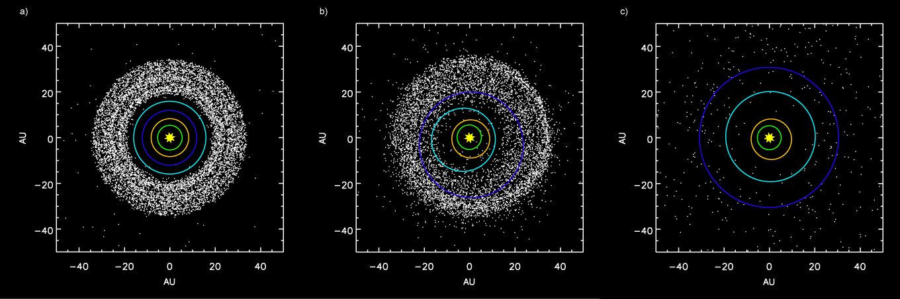
Nice model: Neptune moves outward disturbing cloud of comets or KBOs that are eventually swept away within Neptune’s orbit by the outer planets
Nice Model

Slide 12
New Solutions for Conundrums
The Earth’s Metamorphosis event resolves:
The Late Heavy Bombardment period
The reason for Earth’s large impactor without introducing the Nice model
The reason for the Main Belt of asteroids
An adequate process for the Earth and Moon sharing the same orbit
Why the Moon is really a planet

Slide 13
Proposed Pristine Solar System During Metamorphosis Event
Conditions:
Order of Planets from the Sun:
T-Tauri phase ends with Sun entering main sequence
Most dust and gases are evacuated
All planets are becoming fully differentiated
Inner terrestrial planets developing hardened crusts
Life zone is developed with liquid water on Mars/Gaia
Mercury
Venus
Moon ( at 1.0 AU ) ??
Mars ( at 1.5 AU )
Gaia now Earth (at 2.7 AU )
Jupiter ( at 5.2 AU )
Saturn
Uranus
Neptune

Slide 14
Our Moon as a Planet – Comparison of Gravitational Forces
“Tug of War” ratio = f_{planet} / f_{Sun}
f_{planet} = (G x M_{planet} x m_{moon}) / (d_{planet-m})²
f_{Sun} = (G x M_{Sun} x m_{moon}) / (d_{Sun-m})²
Tug of War = 0.46 < 1.00 only for the Moon
(Sun’s gravity basically holds Moon in its orbit)
Tug of War > 30 for all other primary moons

Slide 15
Our Moon as a Planet - Distance
Primary moon distances are 9600 to 29,000 miles from parent planet
Our Moon is 237,000 miles - Why?
Most primary moons are close to equatorial plane of their planet suggesting a common system and origin
Our Moon is 5.1⁰ to the ecliptic plane and not in the equatorial plane of Earth - Why?

Slide 16
Our Moon as a Planet - Mass
Mass relative to planets and their moons is 100 to 1000 times greater
The ratio for our Moon is only 0.2725 - Why?
Mean density compares more with rocky terrestrial planets than typical icy silicate based moons of the outer planets
Our Moon has a small iron core and a residual magnetic field unlike other moons

Slide 17
Our Moon as a Planet – Orbital Configuration
The Moon's orbit is everywhere concave toward the Sun or always falling toward the Sun; all other normal satellites without exception fall away from the Sun through part of their orbits
The Moon and Earth share an orbit in synchrony one AU from the Sun - Why?

Slide 18
The Moon Enigma – NASA’s Dilemma
Currently accepted nebular hypothesis uses an accretion disk model for the solar system
What possibly could be the origin of this Earth/Moon considering that all planetary orbits of the nebular hypothesis should have but one planet?
Earth as other planets supposedly formed from an accretion of rings of dust, gases, and larger and larger forming planetisimals orbiting inside the proto-star disk

Slide 19
NASA Attempts to Model Earth-Moon System’s Genesis
Binary model fails; different formation processes are required for Earth, Mars, and Neptune satellites
Fission model fails since Earth’s required spin rate of 2 ½ hr./rev. could never slow to 24 hrs.
Capture model most recently abandoned since a brief amount of time cannot reduce Moon’s kinetic energy sufficiently in spite of gas drag and accreting existing satellites

Slide 20
NASA’s Currently Accepted Model
Collision model is supported by computer simulation of a proto-moon glancing impact with impact debris accreting to form Moon
May or may not explain: similarity between Earth’s mantle and Moon’s densities; and common origins of oxygen isotopes found in their crusts. Should these factors be similar?
The model in desperation combines both the fission and capture models in support of Apollo Mission data in explaining our genesis

Slide 21
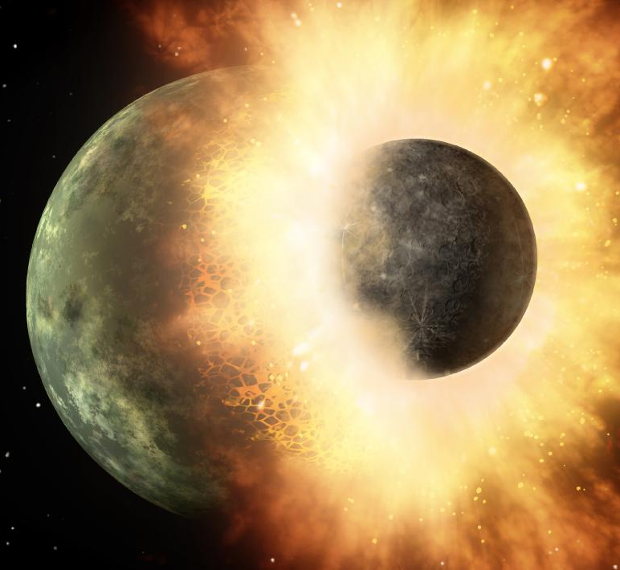
Depiction of Giant Impact Hypothesis by NASA
Such collisions were considered by the academic community as fatal to both bodies leaving only behind only large pieces of debris due to the immense dissipation of kinetic energy. An exception was granted to explain the Apollo Mission data.

Slide 22
Problems with Giant Impact Hypothesis
Same issue as fission model; spin rate too high to achieve adequate angular momentum
Moon rocks do not have sign of vaporization in their chemistry; needs to exceed 1200°K
Moon lacks water bearing minerals like Earth
Liquid mare flows lasting 600 million years
Low velocity impacts causing “mascons” within Moon’s regalith
All these problems are addressed by the new hypothesis, “The Earth’s Metamorphosis” (EMM)

Slide 23
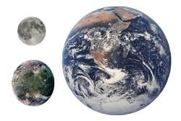
Earth’s Metamorphosis Challenges
NASA’s Giant Impact Hypothesis
Can a combination collision-capture model replace the favored Giant Impact Hypothesis that uses a collision-fission-accretion model?
Can all of the big questions be answered?
The culprits are shown to scale: Earth, Moon and Rogue Planet (Impactor)

Slide 24
Phases of Earth’s Metamorphosis
Solar System is Young and Pristine
Rogue Planet Enters System
Rogue Planet Collides with Gaia
Inelastic Collision with Debris Follows
Orbital Displacement Occurs
Earth Shares Orbit with Moon

Slide 25
The Beginning of Earth’s Metamorphosis - A Rogue Planet Enters Solar System and Orbits Sun
Another possible fifth model to replace NASA’s Giant Impact Hypothesis for the Earth-Moon System Genesis
Combines collision and capture type models
See more details at www.ettingerjournals.com

Slide 26
The Beginning of Earth’s Metamorphosis - A Rogue Planet Impacts Gaia between Mars and Jupiter
Trajectory of Intruder:
Highly elliptical, retrograde , and inclined orbit
Crossing orbital paths of most planets beyond Mars
Aphelion at about 2.7 AU, the orbital location of Gaia
Planet was captured early, within first 900 million years
Planet may actually have been a satellite of a larger captured planet

Slide 27
Proposed Properties of Rogue Planet
Size is between Mars and Ganymede
Mass is roughly that of Mars
Density is due to mostly to frozen volatiles with small iron or sulfur core
Velocity is estimated at 45 km/s; Mercury’s is 40 km/s

Slide 28
Rogue Planet Changes Gaia’s Appearance and Composition
Kinetic energy is absorbed into tilting and displacing Gaia’s orbit
The place of impact creates the expulsion and mixing of materials to create the first granitic giant continent
Gaia’s volume is bloated and causes cracks in the original cooling crust subsequently causing plate tectonics

Slide 29
Resulting New Solar System Configuration
Very molten Gaia absorbs mass of rogue planet in an inelastic collision
Debris is created that forms the Main Belt of asteroids
Other debris is created to cause the Late Heavy Bombardment (LHB) period
Gaia’s orbit is displaced inward almost matching the Moon’s orbital path

Slide 30
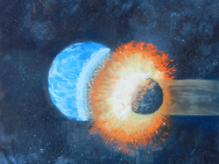
Collision Between Watery Gaia and Frozen Planetoid
The initial contact of a major collision between a watery Planet Gaia and a rogue icy planetoid occurred in Gaia's pristine orbit between Mars and Jupiter about 3.9 bya

Slide 31
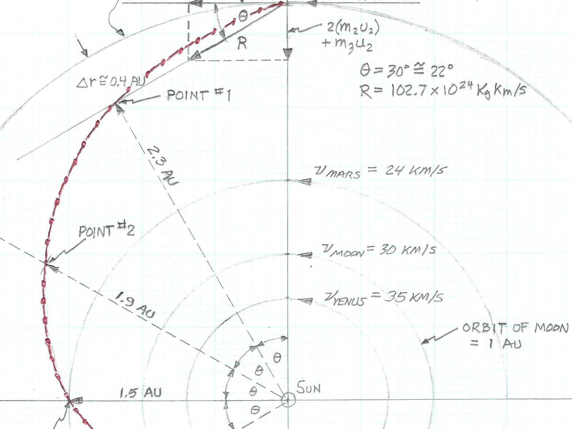
Trajectory of Gaia after Collision with Rogue Planet
Orbital shift stabilizes near the same orbital path as the existing Moon

Slide 32
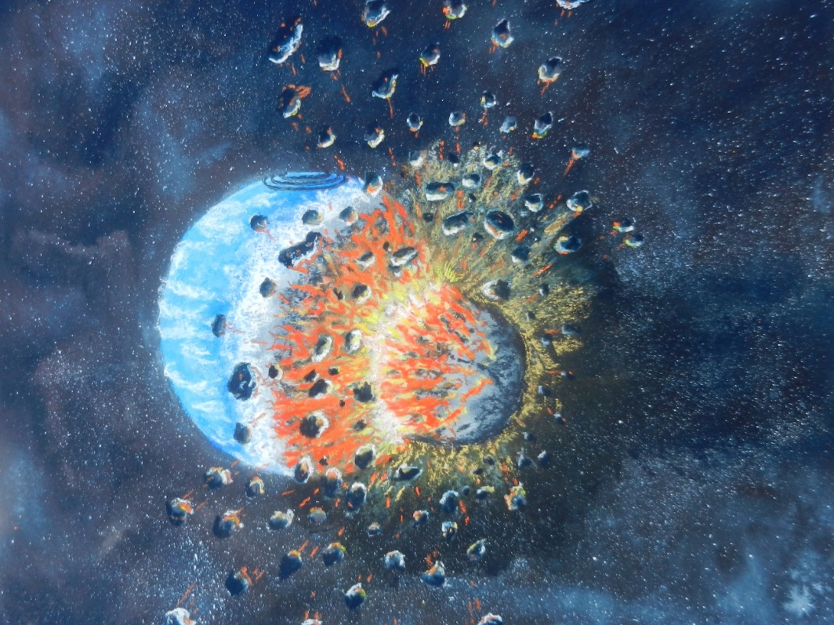
Main Belt of Asteroids is Created
The escaping ejecta and deep engorgement of young Gaia's very molten mantle creates the asteroid belt and an ejected planet. Much of the kinetic energy of collision was transferred to Gaia's orbital displacement.

Slide 33
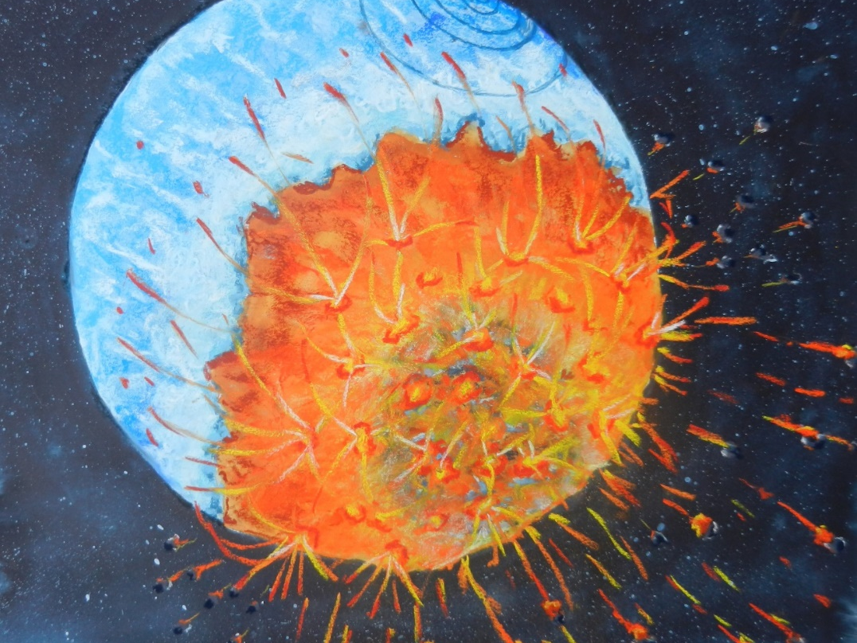
Spin Axis Tilts and First Continent Forms
Gaia tilted on its spin axis having a molten mixture of rock and volatiles from the impactor ooze and bubble from the giant crater and create the original continental granitic crust that displaced and sometimes flowed over the original oceanic crust

Slide 34
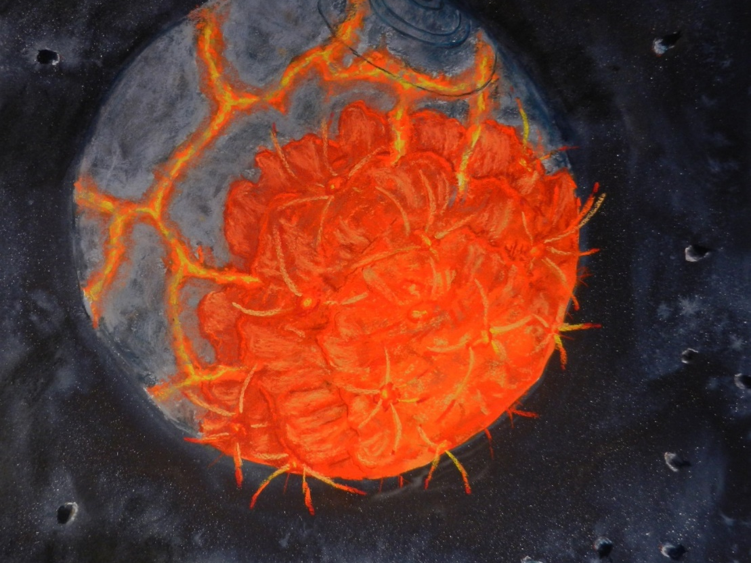
Beginning of Tectonics, Rifts, Volcanism, and Hot Spots
The bloating of Gaia caused its crust to expand and globally crack creating the first major plate tectonics and volcanism in the young solar system. This volcanism replenishes volatiles on Gaia's surface that differentiated inside the mantle.

Slide 35
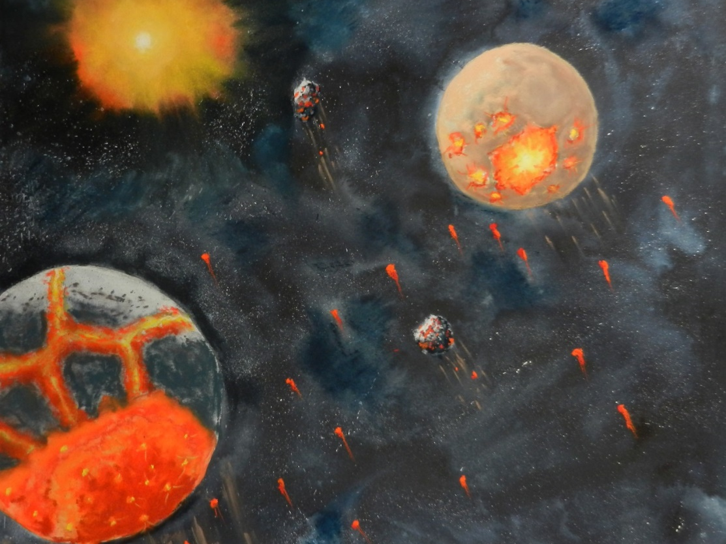
The Falling Earth Brought Debris Near Mars and Onward Toward the Moon
Planet Mars endured falling asteroids that accompanied Gaia as it fell toward the Sun and intersected the Martian orbit. Some large pieces of collisional debris were possibly captured by Mars to become its two moons.

Slide 36
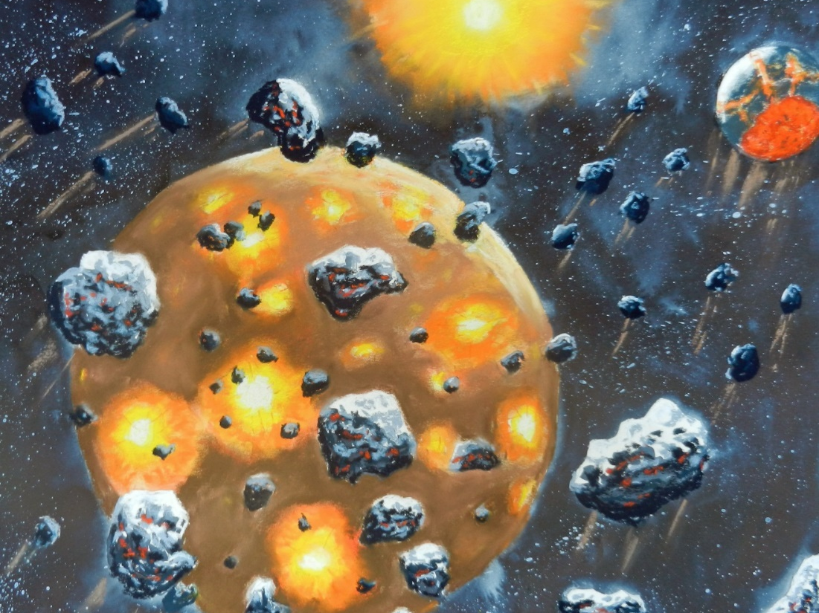
Gaia transforms to Planet Earth as centripetal force matches gravity causing it to share the Moon's orbit
It brings collisional debris that batters the Moon's surface. Their combined local gravity forces caused tidal acceleration forces that slowed Earth over thousands of passing orbits to match the Moon's orbital velocity that then allowed the Moon to move away, that started a synchrony, and that began Earth's stable tilted spin axis and the continental drift process.

Slide 37
The Synchronized Orbits of Moon and Earth
Earth moving faster than Moon passes it every year until gravity forces align orbital velocities
Moon begins to orbit Earth spiraling outward from about 90,000 to 240,000 km
Impact debris after falling on Moon and Earth lessens allowing mares and Earth to cool
Moon becomes tidally locked while continually moving outward to 384,400 km

Slide 38
Event | 10⁹ yrs ago | Distance Apart- km | Moon’s/Earth’s Velocity – km/s | Earth’s Rotation | Moon’s Rotation | Milestones
Earth enters Moon’s orbital region | 3.9 | 90,000 | 30 / 35 | 19.6 hrs | 24 hrs | Earth’s land surface red hot; oceans boiling
Earth slows to match Moon’s orbital velocity | + 29,000 years | 90,000 | 30 / 30 | 19.6 hrs | 24 hrs | Earth cooled, but active volcanism and tectonics
Moon begins to orbit the Earth spiraling outward | ≈22 Moon orbits around Earth | 90,000 + 150,000 = 240,000 | 30 / 30 | 19.6 hrs | 24 hrs | Severe tides: hurricane winds and 1000 m ocean tides
Steady tidal accelerations occur between Earth & Moon; Moon’s mares begin to solidify | 2.9 to 3.0 | 270,000 | 30/30 |  | > > 24 hrs | Collisional debris(asteroids) mostly swept away; bacterial life starts
Moon becomes tidally locked | 2.7 to 2.8 | 278,000 | 30/30 | > 20 hrs | ≈ 0 hrs | Multi-cellular animals appear
Present time | 0 | 384,400 | 30/30 | 24 hrs | 0 hrs (27.3 day orbit around Earth) | Moon receding @ 38 mm/yr & orbiting Earth @ 1.022 km/s

Slide 39
Current Example of Orbital Synchrony
NEOs, near-Earth-objects, have been tracked that follow nearly parallel orbits with Earth
Each time Earth passes, these NEOs are pulled by gravity toward Earth into a different orbit
The new orbits are either closer or farther away from the Sun depending on its prior location
These NEO-type asteroids are too small to slow Earth as the Moon originally did. However, their actions of changing orbital distances shows how synchronicity begins.

Slide 40
Comparative Studies of Scale
The following scaled comparisons follow:
Cross-section of mantles and cores and expansion of Earth’s crust due to penetration of impactor
Off-set of collision causing tilt of axis and migration of molten materials above and below Earth’s crust
Overall size of different bodies; rogue planet is proposed as the size of Ganymede and having a similar density

Slide 41
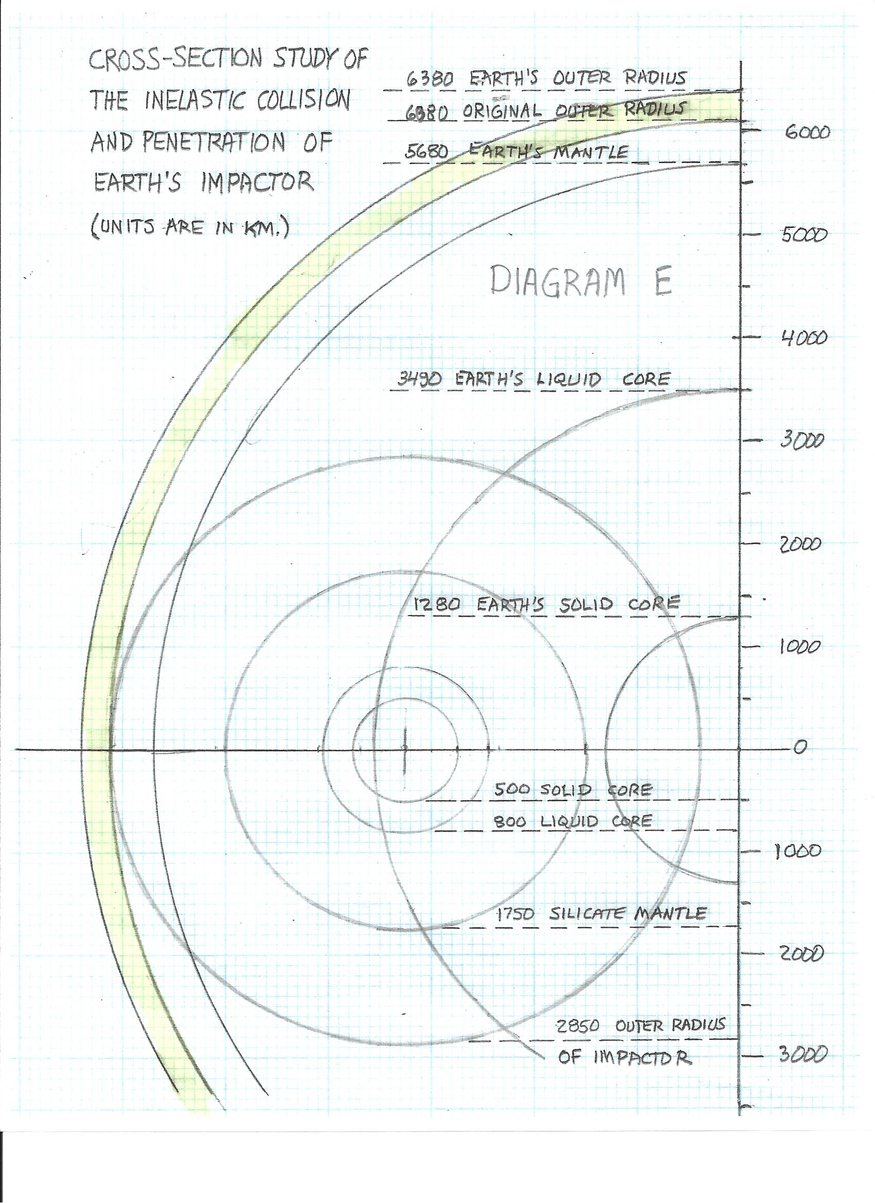
Cross-Section Study of the Inelastic Collision and Penetration of the Earth's Impactor

Slide 42
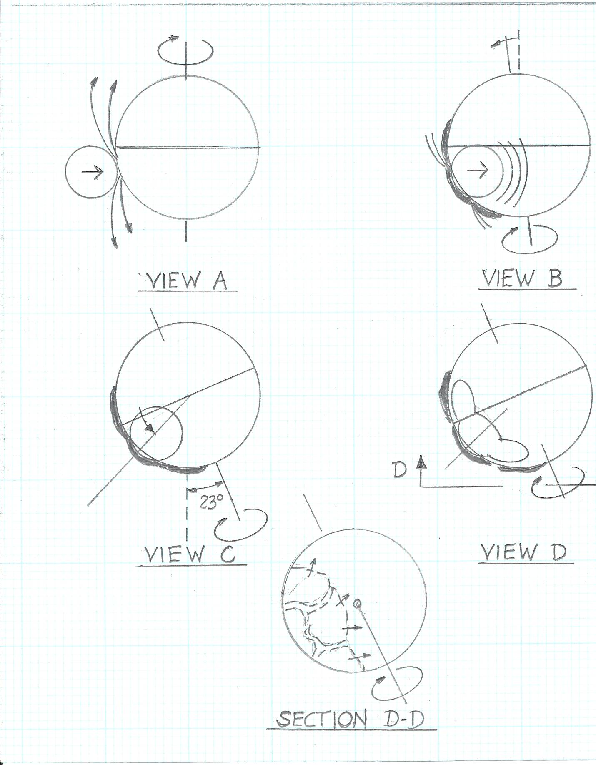
Depiction of How the Earth Stabilized its Tilt

Slide 43
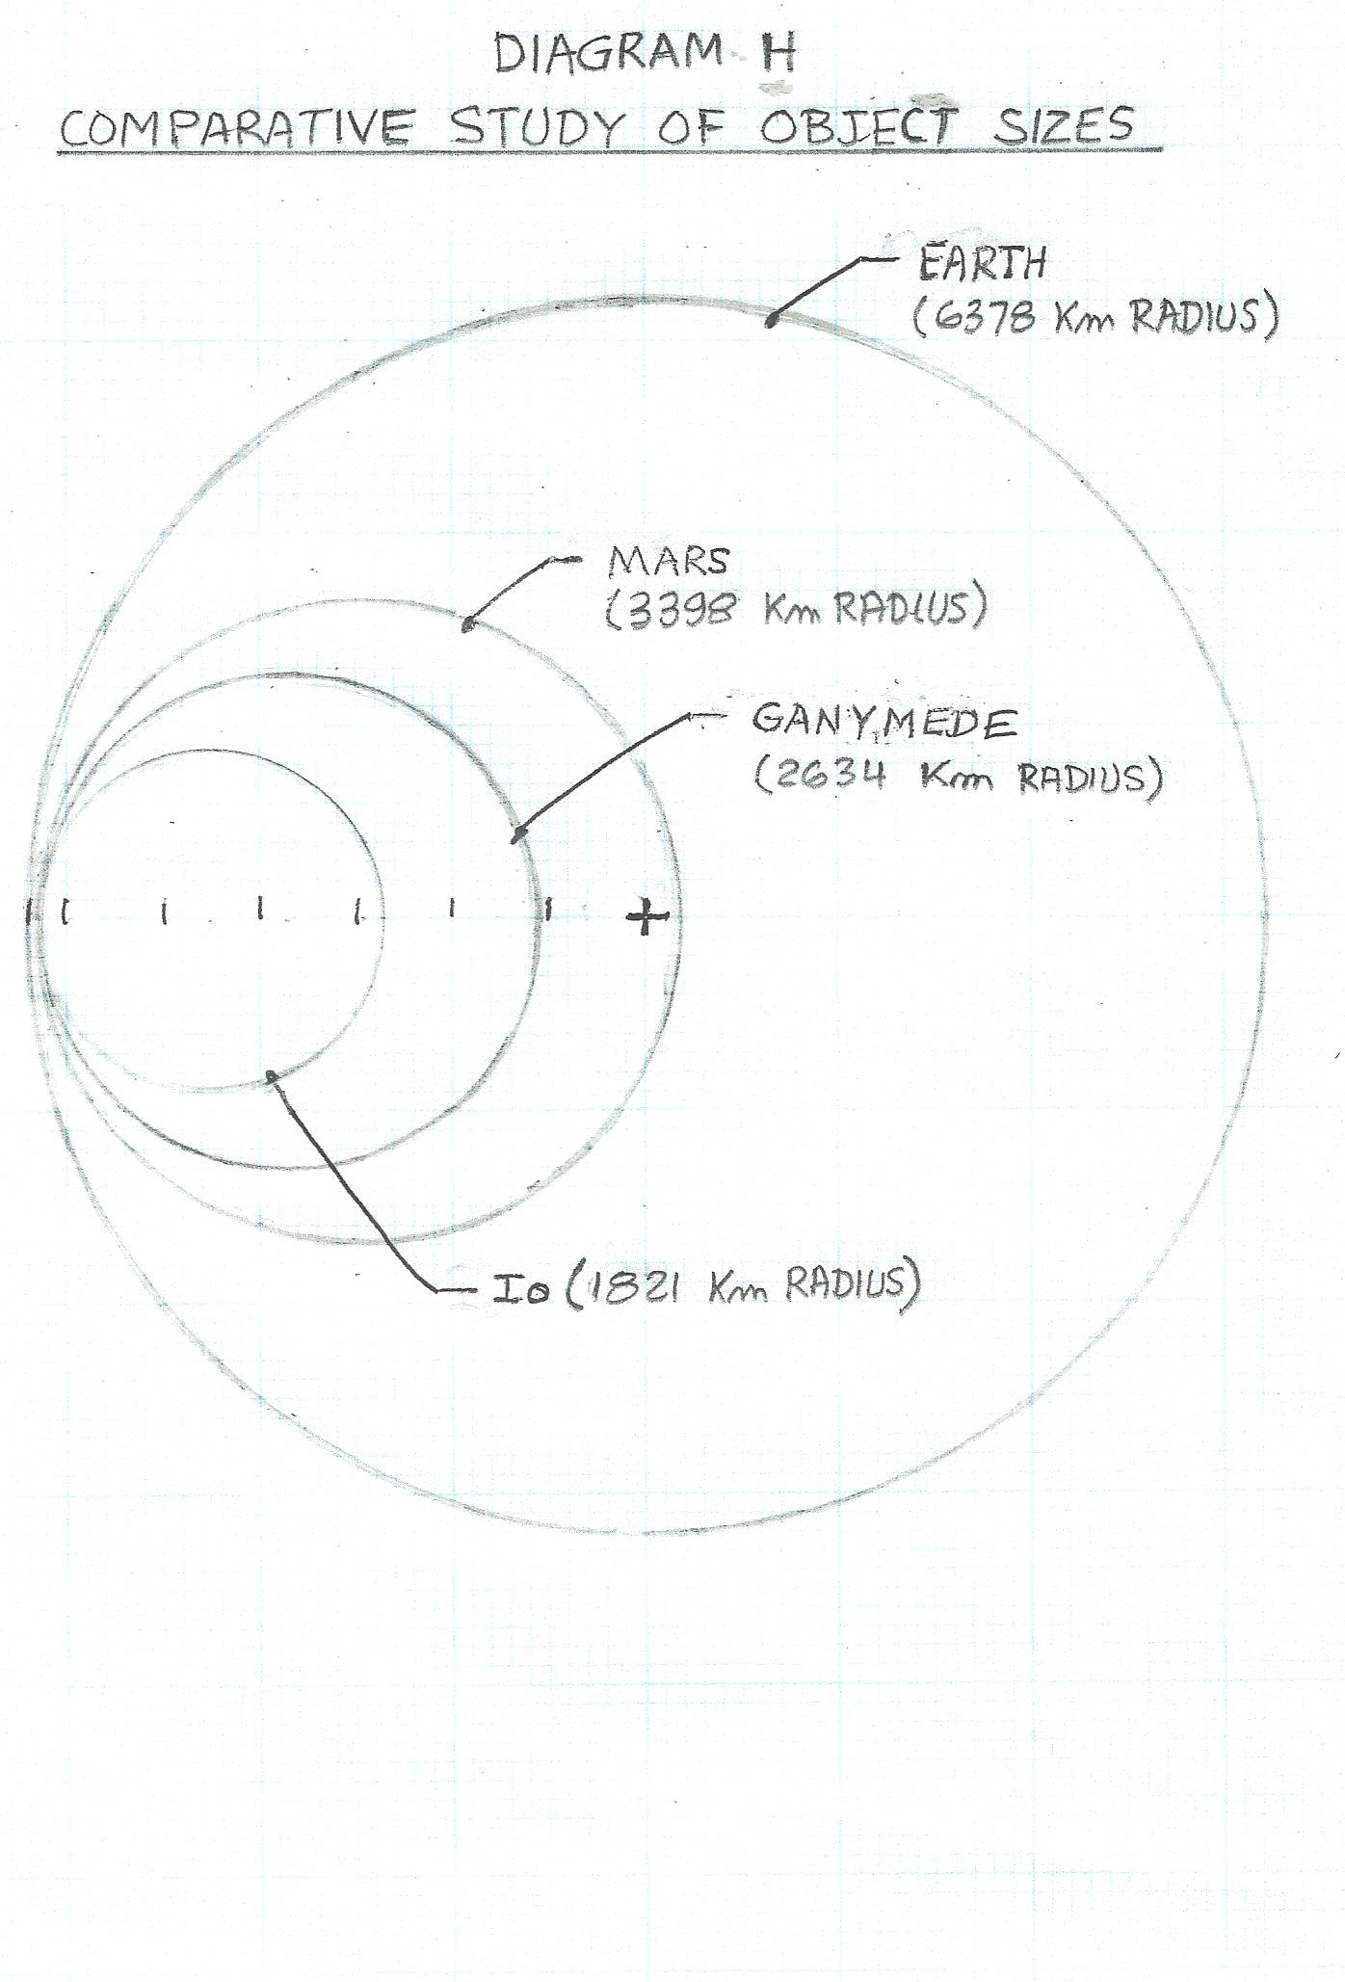

Slide 44
Summary of Earth’s Metamorphosis
(EMM) Hypothesis
This Model Successfully Explains:
Genesis of Earth-Moon system
Tilt of Earth’s spin axis
Existence of granitic continents
Tectonic plates, rifts, volcanism, and hot spots
Main Belt of asteroids
Late Heavy Bombardment (LHB) period
Reasons for Earth’s volatiles of water and atmospheric gases

Slide 45
The Connection to Religion and the Ancient History of the Sumerians
The EMM’s basic story is told by the “Epic Tale of Creation” on Sumerian clay tablets 6000 years ago, as translated by Zecharia Sitchin in 1976 in his book, The Twelfth Planet
The genesis story of the Old Testament, an abridgement of this epic tale, also supports this storyline by stating, “And God made two great lights; the greater light to rule the day, and the lesser light to rule the night”

Slide 46
A Second Presentation is Available for Those Wanting to Explore More
A series of questions with current facts from NASA will be presented to test the EMM and GI Hypotheses. A dialogue with the audience is welcomed.

