Slide 1
What Is the True Genesis of Earth and Moon?
Comparing the Biblical, NASA, and Revised Sumerian Versions

Slide 2
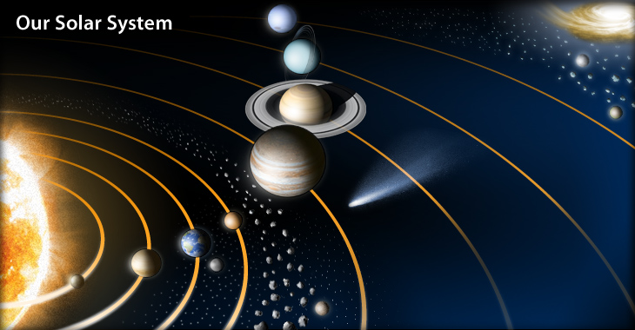
In the Beginning There Was No Earth-Moon System or Main Belt of Asteroids or Comets

Slide 3
Origin of the Biblical Genesis Story
The Old Testament of the Christian and Jewish Bible is well known
These books came from the ancient Hebrews, who adopted a Babylonian version when exiled to this “Cradle of Civilization” land
The Babylonians carried forth a Sumerian version written on hardened clay tablets found in ancient cities such as Ur and Sumer
The original version came from “The Epic Tale of Creation” which was a very detailed account of the creation event
The Old Testament is actually a very abridged version of this epic tale
This Sumer tale was recently re-translated by Secharia Zitchin who claims that the story was handed down to the Sumerians per their own claims thousands of years before. Sumer is estimated to have thrived about 6000 BC. Their epic also includes the story of the Great Deluge (Noah’s Flood).

Slide 4
NASA’s Version Utilizes a Mixture of Scientific Theories Which Have Numerous Problems
Nebula theories of Roche and Laplace:
Solar system begins with rotating cloud of dust and gases
Collapsing nebula flattens along its rotation axis
A lenticular shape of matter forms, with concentration at the center, forming a star
Series of rings are left behind by contracting core
One (?) residual condensation in each ring forms a planet
This same process occurs between most planets and their satellites

Slide 5
Problems with NASA’s Nebula Hypothesis
Sun’s spin axis is inclined 7 degrees to vector of resultant orbital angular momentum of the rest of solar system
The outlying comets and asteroids did not see temperatures high enough to melt silicate materials, part of their composition
The majority of angular momentum is found in the planets
The Earth never saw solar temperatures because of certain light elements found in its crust – thereby refuting the tidal theory
The bombardment of the inner planets is largely unexplained
Finally, why does Earth have a very massive planet-like satellite?

Slide 6
NASA’s Data Collection Harbors Many Difficulties Which Counter Their Accepted Ideas
Two-Body Interaction and Tidal Theories of Buffon and Jeans:
Created by massive, nearby passing star creating a filament
Initial orbits would be elliptical
During first perihelion passages, the Sun would tidally pull
filaments from the proto-planets to create their satellites
Problems with Two-Body Tidal Pulls:
Highly improbable for a very close passing star
Does not address why planets are very co-planar
Volatile materials such as water and ices would be widely
dispersed

Slide 7
The Moon Has All the Characteristics of a Planet – Definitely Not Like Other Major Moons
The Sun’s gravity holds the Moon in its orbit and not the Earth’s
From f = (G x M x m) / r² and the “Tug of War” ratio,
f_{planet} / f_{sun}, the Moon has a ratio of 0.46, which is less than one, unlike all other major moons
The range of all 30 major moons is from 29,000 miles, the minimum “Tug of War”, to 9600 miles, based on the Roche limit where tidal forces break up a closer orbiting object
The Moon is 237,000 miles away and inclined 5.1 degrees to the ecliptic and not in the Earth’s equatorial plane
The mass ratios of all major satellites is 100 to 1000 times more than the Earth-to-Moon ratio of 0.275
The mean density of the Moon compares with the rocky terrestrial planets rather than the typical icy, silicate-based outer planetary satellites

Slide 8
NASA’s Dilemma: Does the planet-like Moon Fit into the Accepted Nebula Hypothesis? No.
How can two planets share the same orbit?
The binary idea of Earth being the parent planet is ruled out
The fission or nebula theory does not fit
The capture theory will not work; not enough time for the Moon to slow down and be caught in Earth’s gravity field
A head-on collision theory can destroy both planets
From desperation, the Giant Impact (GI) hypothesis becomes the accepted model.
A large rogue body grazes the Earth creating the Pacific basin
The remnant and debris from both bodies escapes to orbit Earth
The orbiting debris eventually accretes to form the Moon
A computerized, mathematical model supports the idea combining capture, collision, tidal, and accretion modeling

Slide 9
Major Problems with Giant Impact Hypothesis
In order to have enough kinetic energy to achieve escape velocity for orbit, the collision speed causes the Earth’s rotation to become five hours/day.
The Earth’s equatorial plane is not aligned with the Moon’s orbit.
The floor of the Pacific Ocean basin has young basaltic tectonic plates that do not account for a crater impact that broke through the crust 3.9 bya. Oceanic crusts are very young due to constant continental drift.
Collision is postulated to occur 600 million years after the solar system’s birth, causing NASA to invent the questionable Nice Theory and/or a LaGrangian body in the same orbit that collided with Earth later.
Similar isotopes with different ages of rock and iron content in crustal materials for each body disagree with the GI hypothesis.

Slide 10
Grand Theories are Useless if Minute Details Cannot Be Explained
No answer is given for the Moon’s remnant surface magnetization during the several re-melting periods of its mare basins.
No answer is provided for gravitational mascons centered in cratered basins that indicate low velocity impacts.
No satisfactory explanation for mare formation with ages from 3.8 to 3.0 bya that indicate prolonged impacts after the Late Heavy Bombardment (LHB) period.
Striking differences between the Earth and Moon compositions counter the acceptance of the nebular hypothesis that requires an even mixing of materials inside the proto-star disk.

Slide 11
NASA’s Ego, with All Its Efforts and Expenditures, Not Only Desires, but Actually Requires, Solutions
Scientific hypotheses have generally collapsed when faced with new information.
Statistical treatment, so successful in stellar evolution, cannot yet be applied to a single celestial system since improbable events always happen at least once.
The regular prograde systems of Jupiter, Saturn, Uranus and Neptune do resemble one another; yet, they provide little help for a search of some general principles underlying the formation of planetary systems, especially the Earth and Moon.
The initial state of the system is considered unknown and the final state has only been assembled in the recent history of mankind.

Slide 12
Paradigms in Science Can Possibly Lead Down Wrong Pathways of Thinking
The whole solar system effectively lies in one plane with most bodies orbiting the Sun and rotating in the same direction, leading one to believe in a common origin.
However, each body’s characteristics are uniquely different: the size, the density, the volume, the chemical compositions and abundances, the obliquities, the atmospheres, their magnetization strengths and axis, and surface traumas. Might one suggest a more accurate uncommon origin with bodies thrown together into one over-ruling star’s gravity field?
Gravity is considered the ruling force for our solar system; but then when equations are computerized over long periods of time the system becomes chaotic. Do presently ignored electromagnetic forces come into play to initially create the system, and then keep it stable?

Slide 13
Paradigms Continue to Mislead Well- Intentioned Space Programs Such as Apollo
Scientists keep looking for evidence to prove the Giant Impact (GI) hypothesis. When evidence disproves it, they tend to ignore it or place it on a shelf for future analysis.
Can celestial bodies be easily captured from outside the solar system, perhaps more so when the Sun was first formed inside a star nursery?
Can the solar system capture another minor star system with a very dim brown dwarf (currently undetected) that periodically visits our inner solar system during its perihelion with the Sun?
Is there any possible way of gathering primordial materials together besides a nebular cloud of dust and gases using gravity? Could galactic gigantic electrical circuits create Z-pinches that in turn produce stars?

Slide 14
The Most Important Paradigm Standing in NASA’s Way to Understanding Earth and Moon
The “Epic Tale of Creation”, with some small modifications, explains the Genesis story; NASA’s data from the Apollo missions corroborates the story; and, if attempted, even computerized models would confirm how the Earth was knocked into a different orbit with a tilted axis.
BUT,
NASA scientists and academia simply cannot accept this epic; it is thrown into the trash bin of UFO’s, science fiction, legends, and religiosity (total acceptance of “God’s word”).
Academic thought is locked into thinking that only uniformitarianism exists for mankind’s civilizations - believing that it is just not possible for our level of knowledge to have risen and be destroyed perhaps several different times – although mass extinction of bio-life is now accepted.
Sitchin’s translation reveals ancient astronauts or aliens created us - making the epic both blasphemous for religious folk and pure fantasy for today’s academics. Although the missing links in our genetic history are well accepted, biologists are still looking for natural causes and missing genetic links.

Slide 15
Revised Sumerian Version of Genesis for Earth and Moon
This genesis version answers many issues that NASA cannot resolve, being stuck with current, cherished paradigms.
The story is partially taken from “The Epic Tale of Creation” by the Sumerians. This epic was poorly translated during Napoleon’s era when the clay scrolls were first discovered.
The newest and most accurate translation was made by Zecharia Zitchin in the 1980s and gives a more detailed account of the genesis story, explaining the Earth-Moon-system beginnings.
This presentation will try to align itself with some of the verses in the Book of Genesis in the Old Testament of the Christian Bible. As previously mentioned, the Bible is an abridgement of the Sumer tale.

Slide 16
Revisions and Amendments to the Sumerian Version of Genesis
When I first discovered Zitchin’s translation in his book, The Twelfth Planet, amusement and puzzlement took over my thoughts.
Of course, I was puzzled; how could the Sumerians ever know what happened 4 bya? His explanation in the translation was that a previous advanced civilization, now destroyed, received the epic from even older civilizations.
My curiosity peaked when I read Issac Azimov’s article about why he was certain that our Moon was a planet, which corroborates Sitchin.
Further reading about the solar system revealed that there was no good explanation for the:
  Main Belt of Asteroids
  comets orbiting in varied peculiar orbits
  Late Heavy Bombardment (LHB) 4 bya
  the Earth’s tilt
  the non-alignment of the Earth’s equator and the Moon’s orbit
  where Earth’s water came from, and other mysteries.

Slide 17
To My Utter Amazement, the “Epic Tale of Creation” Addressed Many of the Current Mysteries of the Solar System
A planet orbiting between Jupiter and Mars was struck by a sizable rogue body, which was a satellite of a large planet moving through the inner solar system.
The collision caused debris to be ejected into the inner solar system, but largely created the Main Belt of Asteroids between Jupiter and Mars.
The planet, which was Earth, displaced its current orbit closer to the Sun. Other celestial bodies were involved, but it was not clear how one of them became the Earth’s Moon.
The problem with Zitchin’s translation was that other attendant bodies would more likely not follow its new trajectory except collisional debris; I later revised this part of the story by having the Moon already reside in Earth’s new orbit. Hand calculations using energy conservation were used to verify this possibility.

Slide 18
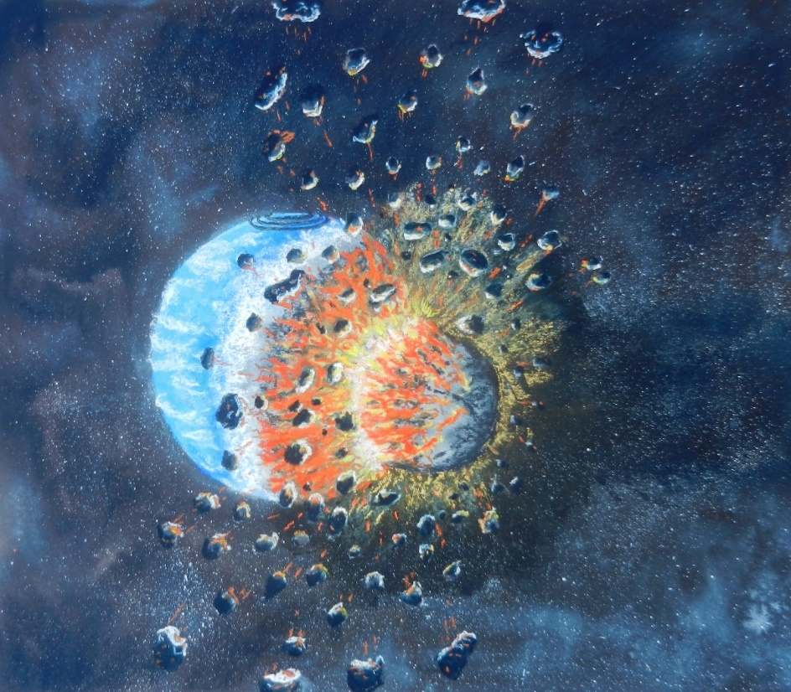
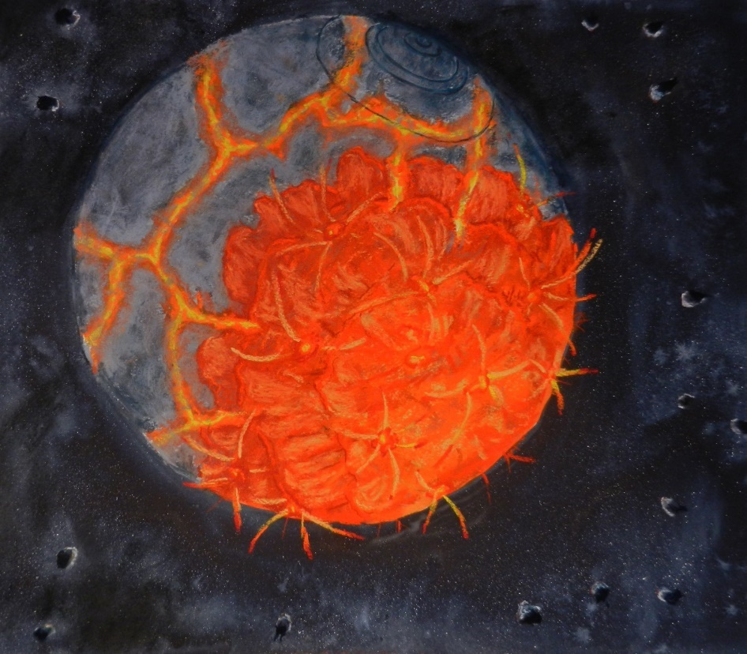
Rogue Planet Strikes Earth and Gorges Mantle

Slide 19
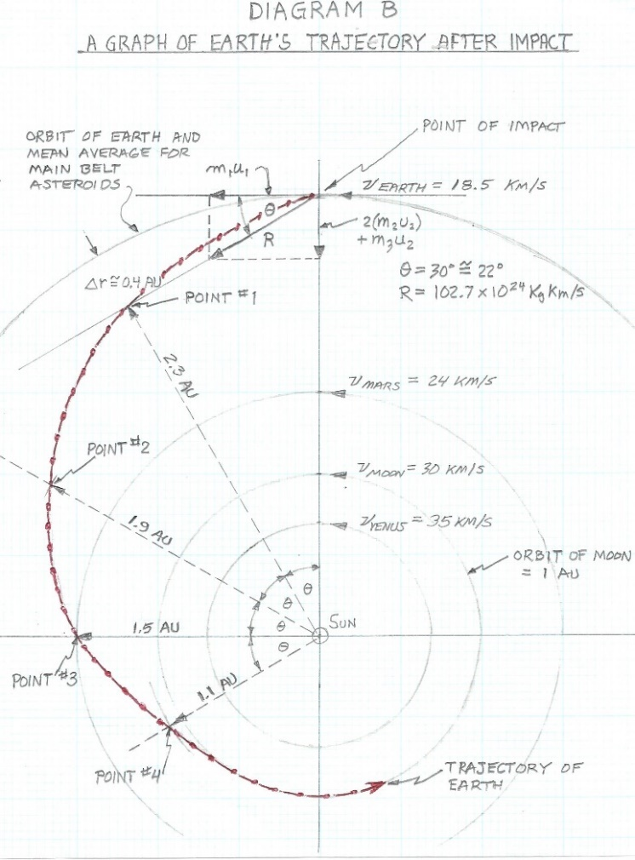
Earth’s Collision with Rogue Planet 4 BYA

Slide 20
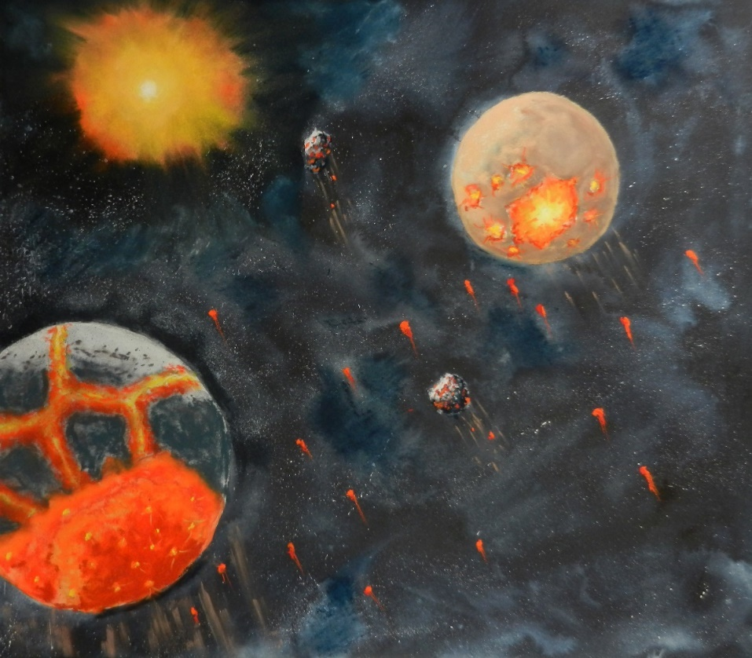
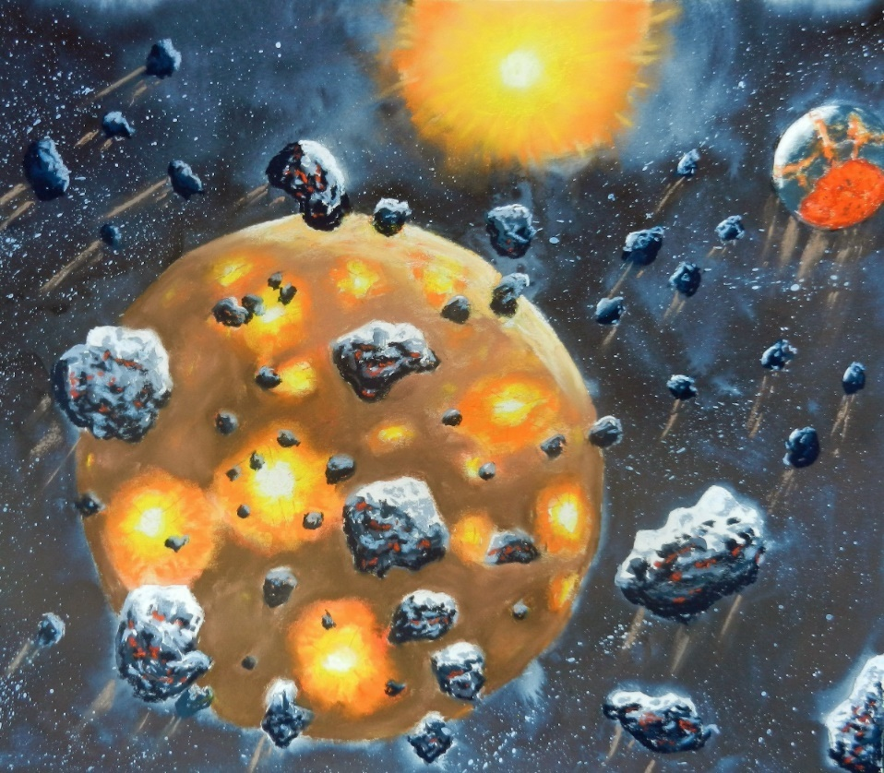
Earth Falls Toward Sun, Passing Mars, and then Shares Orbit with Moon while Bringing Debris

Slide 21
Other Explanations Fulfilled by Sumer’s Epic
Because of repeated passes of the slightly faster Earth, not only was the Moon captured but became synchronistic with Earth’s orbit.
The Late Heavy Bombardment (LHB) is explained, including the Moon continually sweeping debris that came from the site of Earth’s impact.
An impact basin is not required since the rogue planet penetrated Earth due to a very soft molten young planet, creating a very low restitution, close to zero; complete destruction of both bodies could not happen, like two billiard balls striking each other at high velocity.
The lighter, granitic continents of Earth are created from the mixing and eruption of Earth’s molten mantle and ices from the impactor that then flowed over the remaining hardened oceanic crust.

Slide 22
Why Does Earth Have Certain Major Features that No Other Celestial Body Has?
Plate tectonics is explained because the already existing crust is raised, thereby creating several major plates globally.
Volcanism and earthquakes are explained because the lighter, more volatile materials of the rogue planet began to rise to the surface – a process called differentiation, or the separation of different material densities in a molten environment with a gravity field.
Continental drift is explained because the original large crater oozed material that hardened to create a very large land mass above ocean level; this continent than broke apart and drifted on top of the heavier magma to achieve an equilibrium for the resulting unbalanced rotating Earth.
The icy rogue planet brought more volatiles to Earth that escaped from rifts and volcanoes through the expanded existing basaltic crust.

Slide 23
No Other Existing Theory Can Explain So Many Different Phenomena With Its Sequence of Events
Dirty snowball comets are no longer required to bring water to our planet. Water already existed on Earth because it was created beyond the solar system’s “snow boundary” beyond Mars; then the icy impactor delivered more volatiles including N₂ and CO₂.
Geological, wandering “hot spots” such as the ocean’s island groups, the Deccan and Siberian Traps, and Iceland are explained because trapped volatiles escaped through the oceanic crust at random locations which rightly has no relation to raised mountain ranges caused by tectonic plates being pushed under another due to continental drift.
The age and isotope-identities are different for the Earth and Moon and the age of the oldest rocks on Earth are about 3.9 billion years – all explained by the Earth and Moon not being formed together, and by Earth’s original continental crusts, called cratons, formed during the 3.9 bya impact.

Slide 24
Examination of the Biblical Genesis and the More Technical Account of the Sumer Epic
Verses from the Book of Genesis within the Gideon Holy Bible are quoted.
The Bible uses “days” as a chronological listing which must be translated as different phases of the overall creation events. “Day” is relative. Is that time period of an Earth day, a Jupiter day, or a galactic day?
  The first day is considered as the phase that creates all primordial matter, the stars, and the much larger galaxies.
  The fifth and sixth days deal with life in general and mankind being created after the light of both the Sun and Moon are received by Earth
  The seventh day, of course, is the day reserved for rest and celebration
  This presentation specifically deals with the creation of the Earth and Moon system and their placement within the solar system, which are described in the 2nd, 3rd, and 4th days or phases

Slide 25
With Some Inductive Reasoning and Clarifying a Few Words, the Bible’s Genesis Story Becomes the “Epic Tale of Creation” by the Sumerians
The following word clarifications are utilized:
Firmament: this is the hard, silicate-based, crustal surface of any terrestrial planet where life can possibly survive, unlike the surface of a star or icy satellite or an electrically charged comet.
Heaven: the firmament becomes heaven when waters form above and below its surface. Heaven is the oceans, crust, and atmosphere.
Waters: waters can be either in a liquid or gaseous state and can include the atmosphere that not only contains water vapor, but also nitrogen, oxygen, methane, and CO₂ that are required by life. Not well known, these volatiles also exist under the Earth’s surface and are released regularly via rifts or large cracks in the crust and via volcanism that still continues to this day. Currently, these waters are being release by gas well fracking processes.

Slide 26
A Serious Question Is Posed: How Did the Sumerians in 6000 BC Receive this Information that Pre-dates Them by Millions/Billions of Years?
The second day –
“Let there be a firmament between the waters to divide waters from waters. … so God made the firmament and separated the water under the firmament from the water above the firmament. God called the firmament Heaven.”
The interpretation is that the rogue impactor brought to Earth more needed volatiles and impregnated the mantle with these materials.
A mixture of materials from Earth’s mantle and the icy impactor oozed from the impact crater and created both a molten firmament below and above the first crustal formations.

Slide 27
Was God the Originator and Provider of this Genesis Story that is Now Being Corroborated by NASA Observations and Data from its Space Program Ever Since the 1960s?
The third day –
“Let the waters under heaven be gathered into one place and let the dry land appear. … God called the dry land Earth and the gathering of the waters He called Seas.”
As translated, the impact materials that erupted from the giant crater and oozed on top of the oceanic crust cooled and solidified forming dry land.
The entire surface of the Earth cooled sufficiently that the steam and water vapor eventually condensed to form rain and create the oceans.

Slide 28
Perhaps a Superior Civilization Acquired This Information Similarly to Us and Was Destroyed
The fourth day –
“Let there be lights in the firmament of heaven to divide the day from the night; let them be markers of seasons, days, and years, and for luminaries in the firmament of heaven to shed light upon the Earth. God made the two great luminaries, the greater light for ruling the day and the lesser light with the stars for ruling the night.”
The Earth’s orbit was displaced much closer to the Sun where its light would be so much more significant than when it was beyond Mars.
The Earth’s new orbit and year shared the same orbit as the Moon’s when the two bodies became synchronous with each other; the Moon’s reflected light was shown most nights on Earth.
The Earth’s resulting tilted spin axis produced seasons which were identified or marked by the path of the Sun across the Earth’s sky.
The Moon’s phases divided and marked equal periods for each yearly cycle.

Slide 29
If a Previous, Much Superior, Civilization Existed and Was Destroyed, the Following Questions are Posed
Did these people have the same curiosity as us about their genesis?
Did these people create us in their image, but not as smart, to be their servants?
What happened to this previous civilization? Were there more than one, with repeated births and destruction?
Did a global, natural catastrophic event occur, or did they destroy themselves such as we can with nuclear weapons?
Does any evidence of their previous existence exist? Perhaps the great megaliths are that evidence? Are they still secretly here amongst us?
Obviously, they did exist because I can corroborate their genesis story.

Slide 30
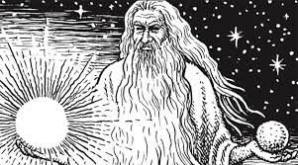
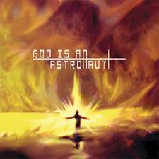
Who Gave Us the Genesis Story? The True Creator, Ancient Astronauts, or Lords of Some Past Civilization Now Destroyed?

Slide 31
Let me address your immediate and pressing concern. What happens to us after death?
If there is no omnipotent or omnipresent God, who sorts us at the pearly gates? What happens to us after death? A wise prophet of old said to not fear death. Don’t let false prophets make you believe otherwise. Why?
Our bodies are like TV sets, computers, or radios. These devices die if their parts go bad, or the plug is pulled, or the battery loses power, or the appliance is smashed to pieces.
But, the signals that these devices or our bodies are or were receiving live on.
These memories or the spirit in the cloud, including individual spirits, are all saved.
Any spirit, including ours, can be downloaded to another body at any time in the future if it wishes to live again within creation’s firmament that the ancients called heaven. Do other firmaments exist?

Slide 32
Note of Caution
DO NOT RUSH TO RETURN AFTER DEATH.
CAREFULLY CHOSE A
GOOD TIME AND A GOOD NEIGHBORHOOD.
IT IS NOW OUR RESPONSIBILITY
TO PROVIDE A GOOD TIME AND A GOOD PLACE BOTH TODAY FOR US AND TOMORROW FOR RETURNING SPIRITS.

Slide 33


Rejoice in Your Ride on This Spaceship, Earth, Which You Now Know to Be the Firmament or Heaven

