Slide 1
The Connection Between Nutrition, Cancer, and Long Term Health

Slide 2
My story begins with a diagnosis of prostate cancer in July 2014
I was faced with the options of radiation treatments, removal of the prostate, or take my chances leaving the cancer inside my body.
I chose surgery in December of 2014 with subsequent follow-up of bi-annual blood checks.

Slide 3
Could this cancer have been prevented?
Did I have other choices in treatments that are less intrusive?
Could I have avoided this cancer with preventive measures?
Can I avoid future cancer at this time?
The answers are all “yes”.
I am going to tell you what I learned.

Slide 4
I am sure your reactions will be highly dispersed
From:
I already have taken these actions.
I may consider taking a serious life style change from what was told.
It is too late for me to make changes; we all die anyway.
I believe in the current medical and scientific facts (beliefs?) and will follow their guidance.
To:
I cannot help but laugh about such quackery.

Slide 5
What I learned recently came from the book The China Study
The China Study was written by T. Colin Campbell, PhD, and Thomas M. Campbell II and published in 2006.
The book is based on a comprehensive study of nutrition conducted in China in the early 1980s by both Chinese and American researchers.

Slide 6
Mankind’s diseases can be categorized into two basic groups.
Diseases of Affluence (Nutritional extravagance)
Heart disease; cancer (colon, lung, breast, liver, leukemia, stomach, and prostate); diabetes; obesity; and auto-immune diseases.
Diseases of Poverty (Inadequate nutrition and poor sanitation)
Pneumonia; intestinal obstruction; peptic ulcer; pulmonary tuberculosis; parasites; rheumatic heart disease; and endocrine system diseases.

Slide 7
Present Status of Modern Western Infrastructure and Medical System
Handle very well the diseases of poverty.
But have no stated preventive steps for cancer, heart disease, or diabetes.
The AMA mostly provides drugs and mechanical and surgical treatments for these diseases.
The AMA only becomes assertive after people have acquired certain diseases, but has no expectations of reversing or stopping the disease. You pay dearly to add a few more years, mostly painful or uncomfortable, to your life.

Slide 8
Recent, limited preventive advisories by the AMA and FDA
Reduction or stoppage of smoking.
Reduction of alcohol consumption especially for certain situations.
No smoking or alcohol intake for pregnant mothers.
Listing of certain broad food group limitations.

Slide 9
So what is the AMA/FDA record of results with diseases of affluence?
Have healthcare expenditures declined? No
Or declined as a percent of the US GDP? No
Have cancer death rates declined? No
Has obesity or diabetes as a percent of the population declined? No
Have the auto-immune diseases been eliminated, especially for young children? No, they are increasing.

Slide 10
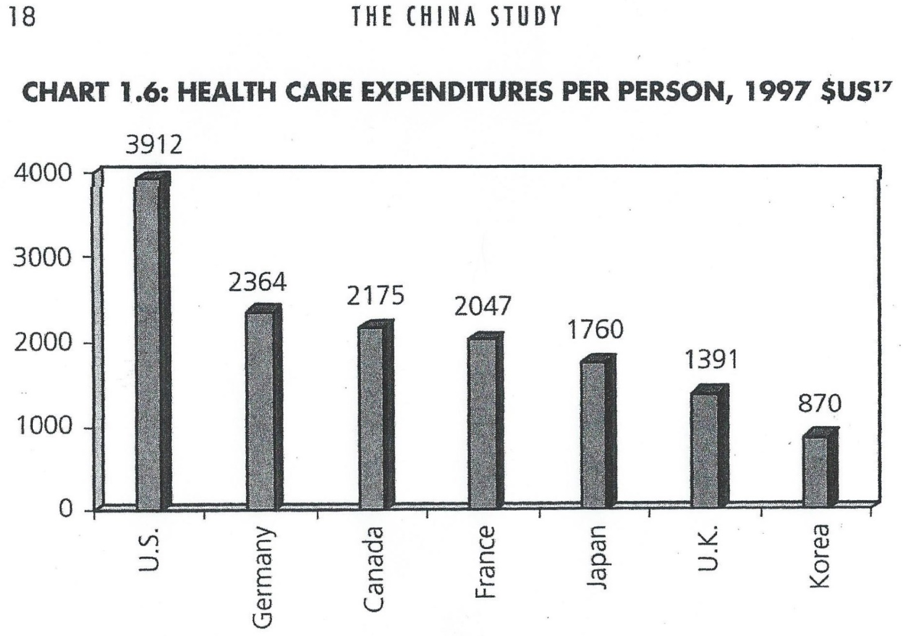
1997 Healthcare Expenditures Per
Person in US$ Highest in US

Slide 11
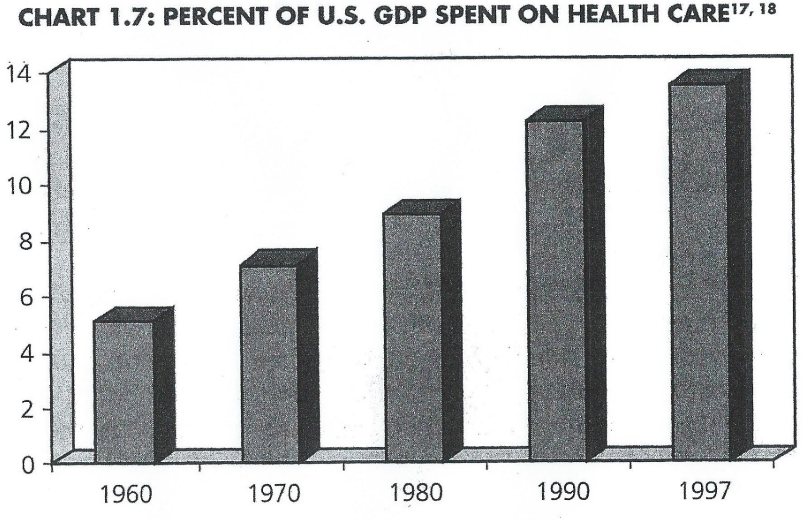
Percent of US GDP Spent on Healthcare Rising

Slide 12
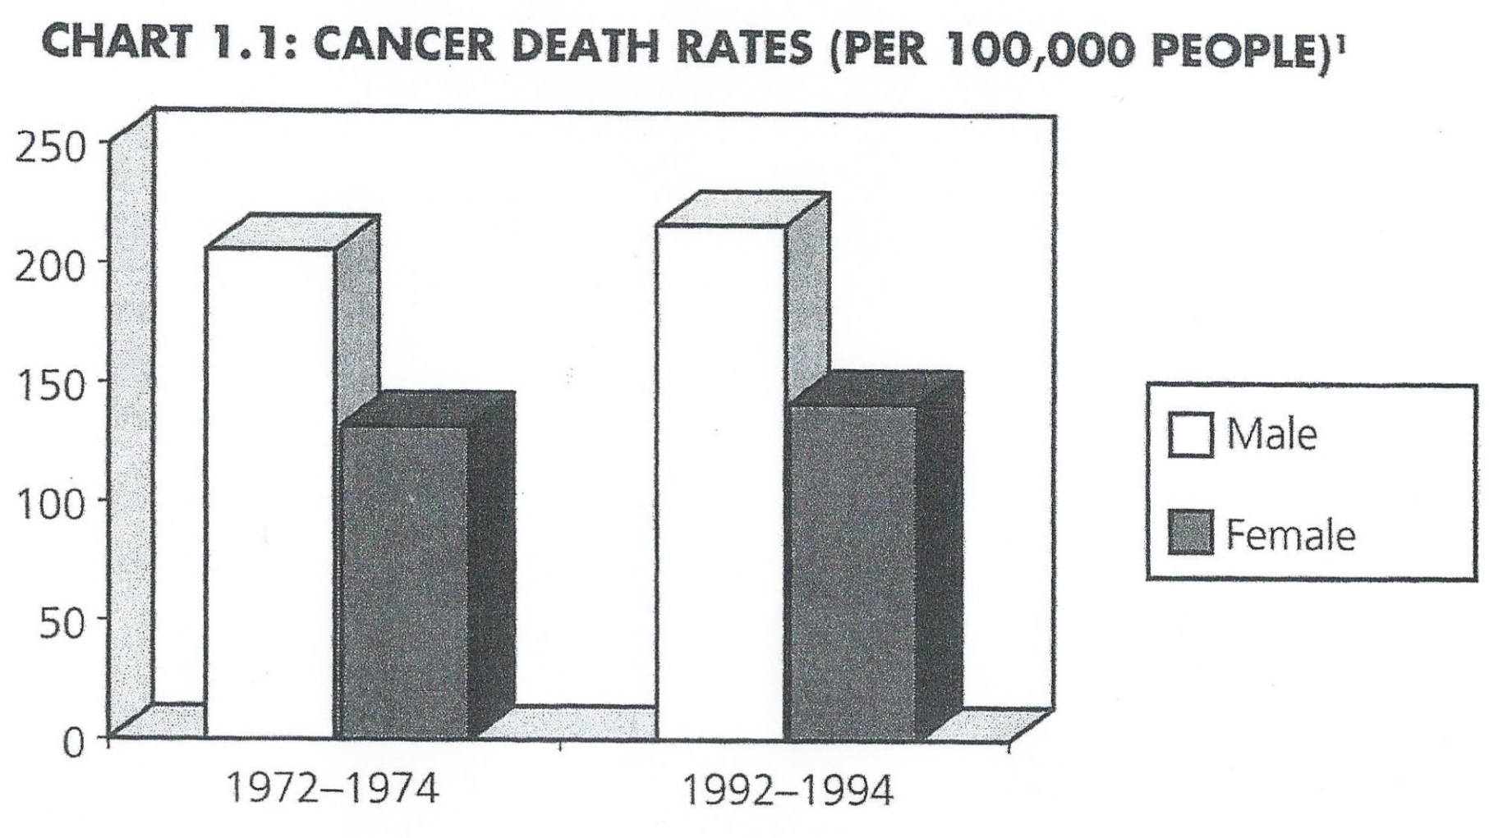
Cancer Death Rates Rising

Slide 13
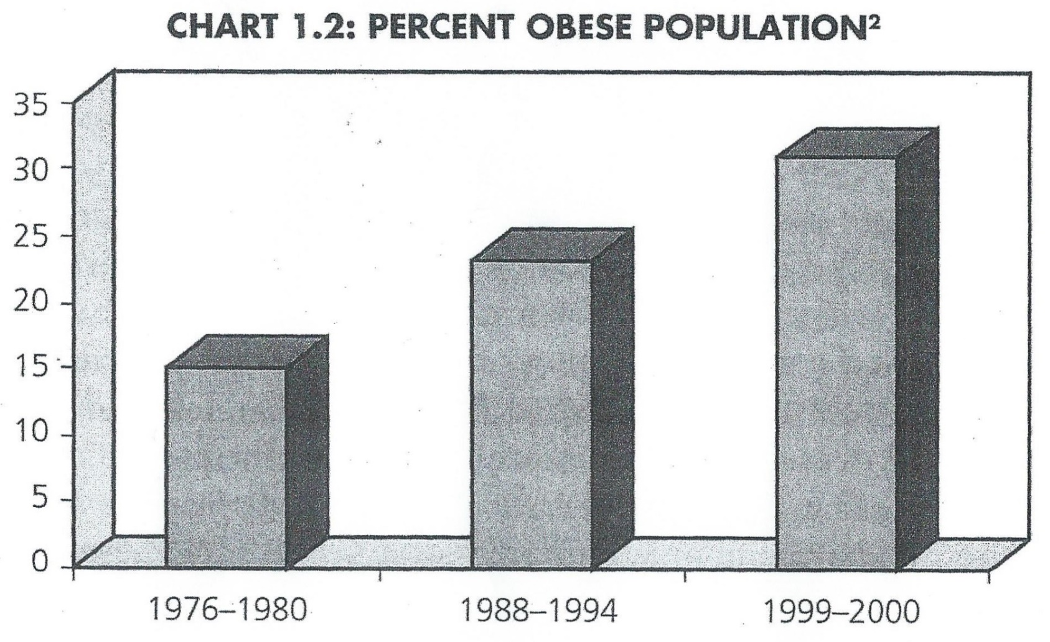
Percent of Population that is Obese Rising

Slide 14
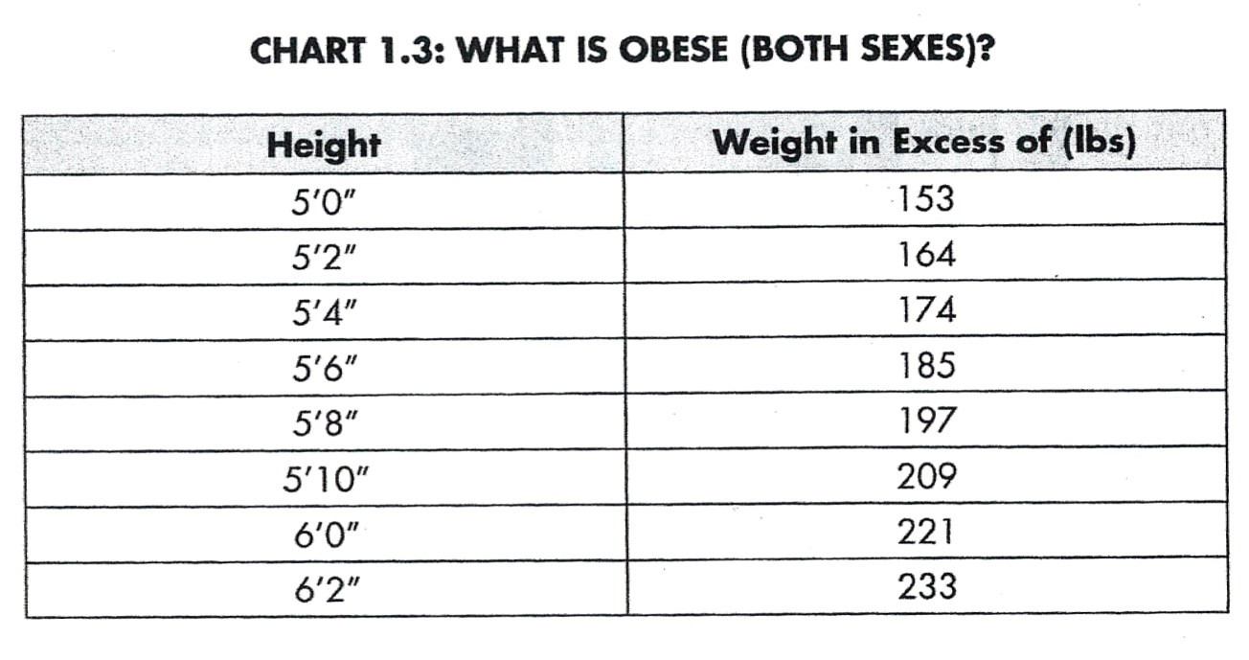
Definition of Obese

Slide 15
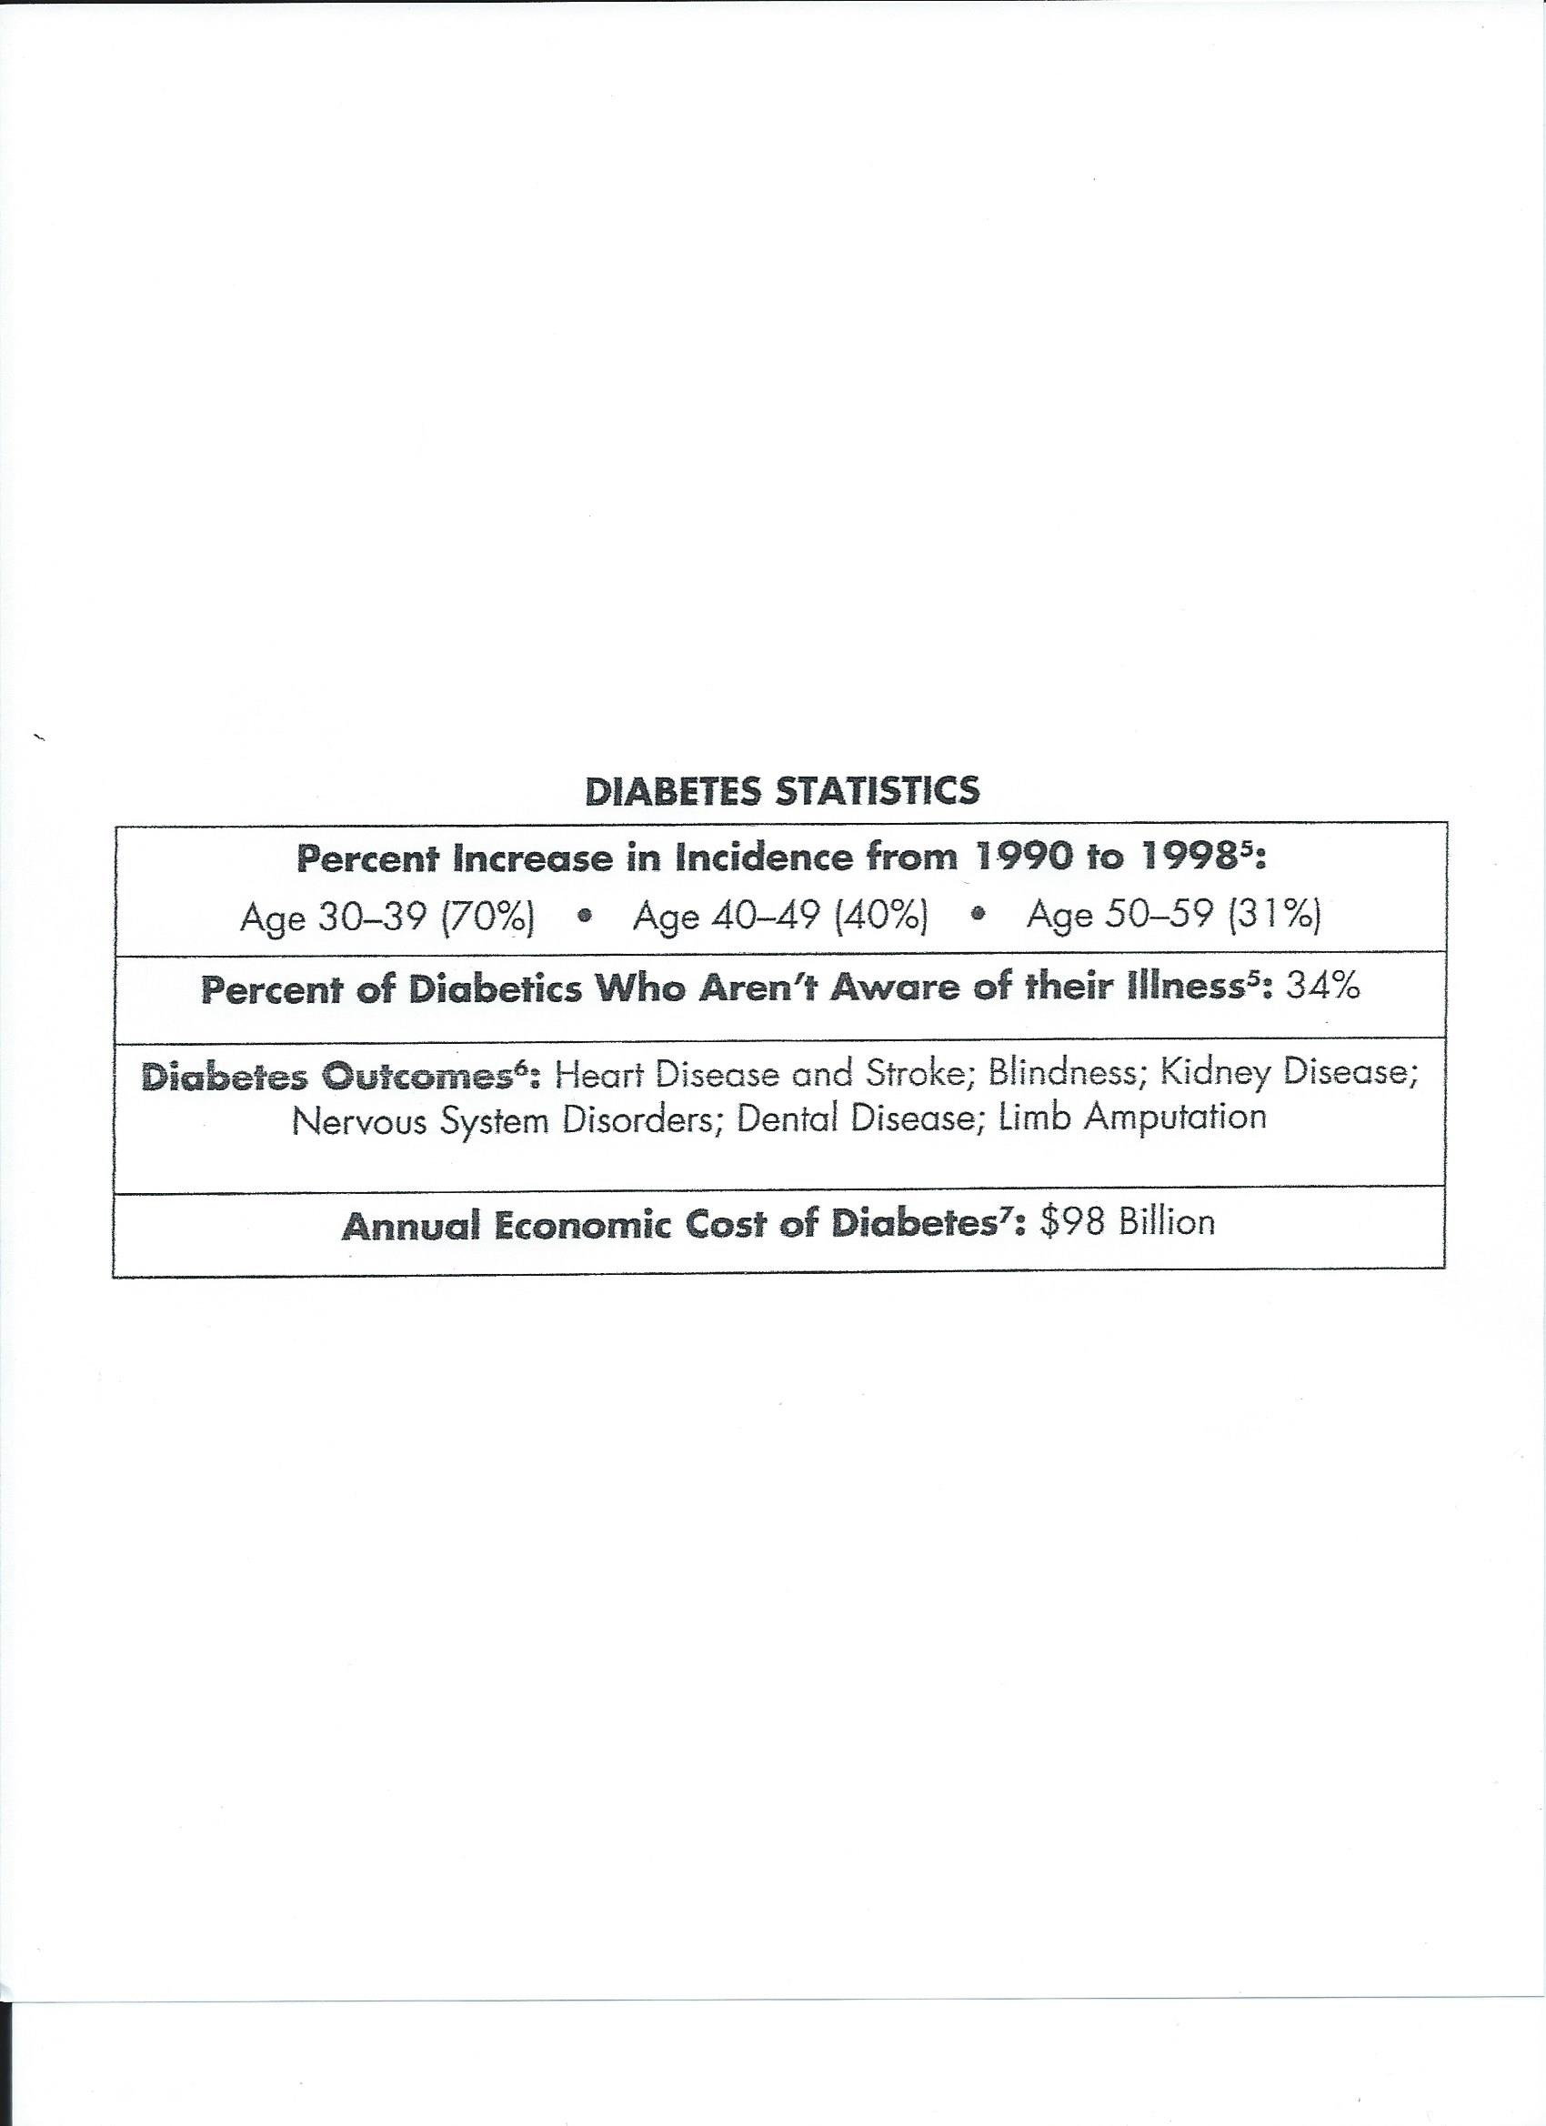
Diabetes Rising

Slide 16
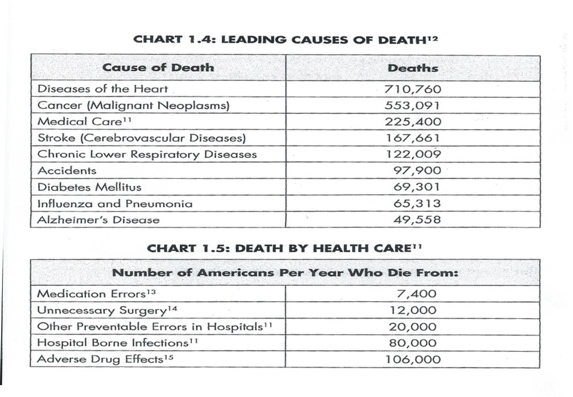

Slide 17
Lessons from China
A monumental survey of death rates for twelve different kinds of cancer was conducted in the early 80s.
In 2400 Chinese counties
For 880 million citizens (96 %)
Using 650,000 workers for the survey

Slide 18
Results of the China Survey
Cancer was geographically localized.
Certain types were high in some areas and non-existent in others.
Survey based on 87% of population coming from one ethnic group, the Han people.
Cancer is largely due to environmental/lifestyle factors and not genetics.

Slide 19
Some areas had low cancer rates
Certain rural, isolated counties had almost zero incidences of cancer
Cancer was very high in certain rural counties and not in others due to dietary experience.
Differences were incredibly large, unlike surveys conducted in the US, due to isolated lifestyle.
This difference in cancer rates also coincided with other diseases of affluence from further studies.
Their nutrition was based on whole foods, low fat foods, high fiber, least amount of processed foods, and extremely important, only plant-based foods (grains, fruits, and vegetables).

Slide 20
Plant-based vs. animal-based foods
Thousands of different studies show protective benefit of plant-based foods and/or harmful effects of animal-based foods for so many unrelated different diseases such as:
Osteoporosis, kidney stones, blindness,
cognitive dysfunction, and Alzheimer’s
disease
These maladies are not the result of inevitable consequences of aging; they have a dietary link.

Slide 21
The Conclusive Result
Can it be coincidence?
Can it be bad data?
Is it biased research?
Is it misinterpreted statistics?
It is extremely doubtful that all these previous combined findings are not revealing the truth.

Slide 22
What is wrong with the immense number of surveys conducted in the US?
Most of these surveys use “reductionism” and study one or a few vitamins and/or minerals at one time, not taking into account the whole interconnected system.
All the people used in these surveys are already victims of the affluent lifestyle that has inadequate nutrition.

Slide 23
Eating Right
The author of The China Study lists eight principles of food and health
Nutrition represents combined activities of countless food substances. The whole is greater than the sum of its parts. (See chart for spinach.)
Vitamin and mineral supplements are not a panacea for good health.

Slide 24
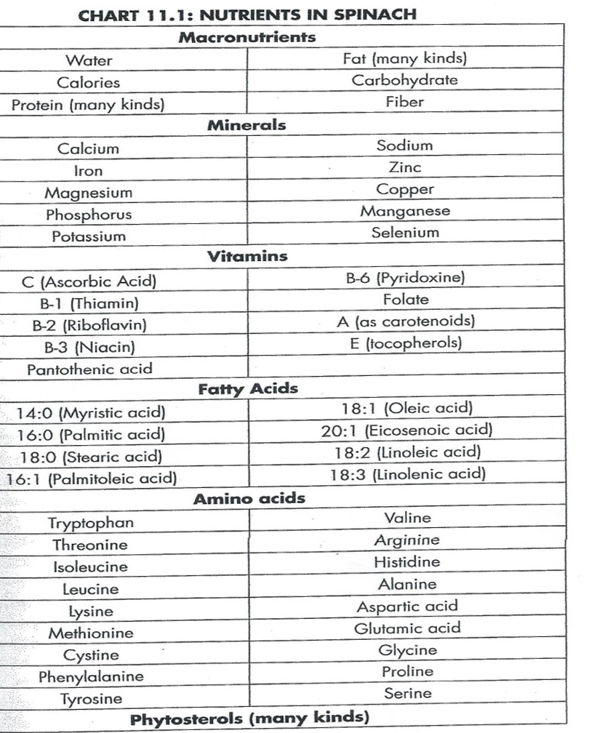

Slide 25
Eating Right
There are virtually no nutrients in animal-based foods that are not better provided by plants. (See chart of Nutrient Compositions.)
Genes do not determine disease on their own. Genes function only by being activated, or expressed; and nutrition plays a critical role in determining which genes, good and bad, are expressed.

Slide 26
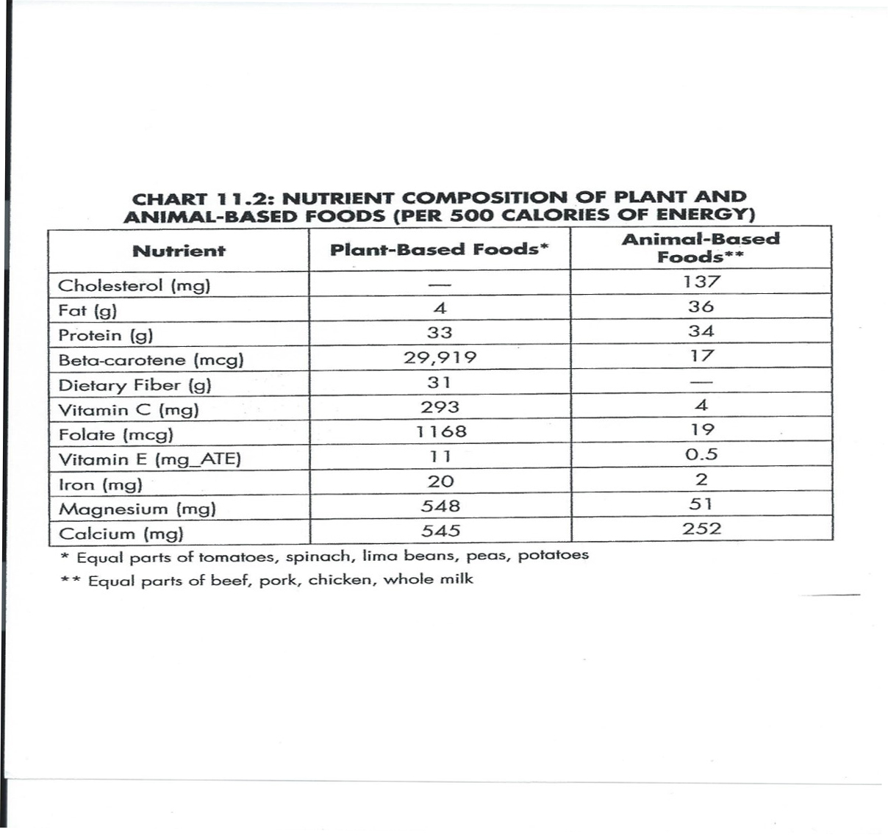

Slide 27
Eating Right
Nutrition can substantially control the adverse effects of noxious chemicals and GMOs.
The same nutrition that prevents diseases in the early stages (before diagnosis) can also halt or reverse disease in the later stages (after diagnosis).

Slide 28
Eating Right
Nutrition that is truly beneficial for one chronic disease will support health across the board for all these diseases.
Good nutrition creates health in all areas of our existence. All parts are interconnected. (See chart for “Eat All You Want”).

Slide 29
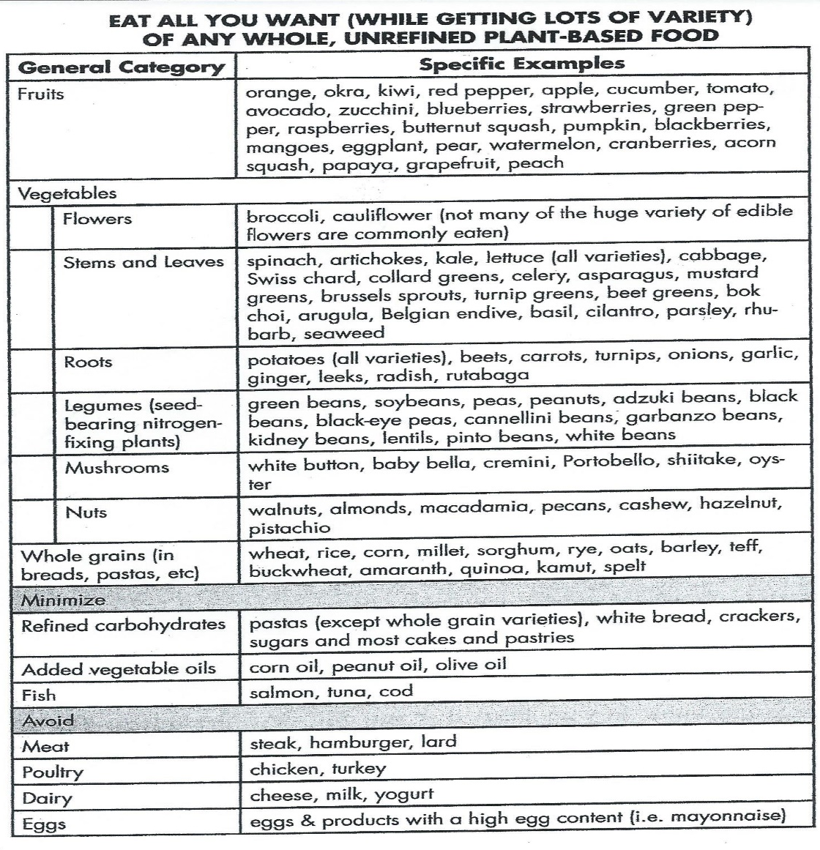

Slide 30
“Misinformation”
The Food and Nutrition Board (FNB), as part of the Institute of Medicine (IOM) of the National Academy of Sciences, has the responsibility of updating recommended consumption of individual nutrients.
- since 1943 when this task started for the army during WWII.

Slide 31
FNB’s Official Advisory (2002)
To meet the body’s daily energy and nutritional needs while minimizing risk of chronic diseases adults should get their total calories as
  45 to 65% from carbohydrates.
  20 to 35% from fat.
  10 to 35% from protein.
  (and to make things even worse)
  no more than 25% added sugars.

Slide 32
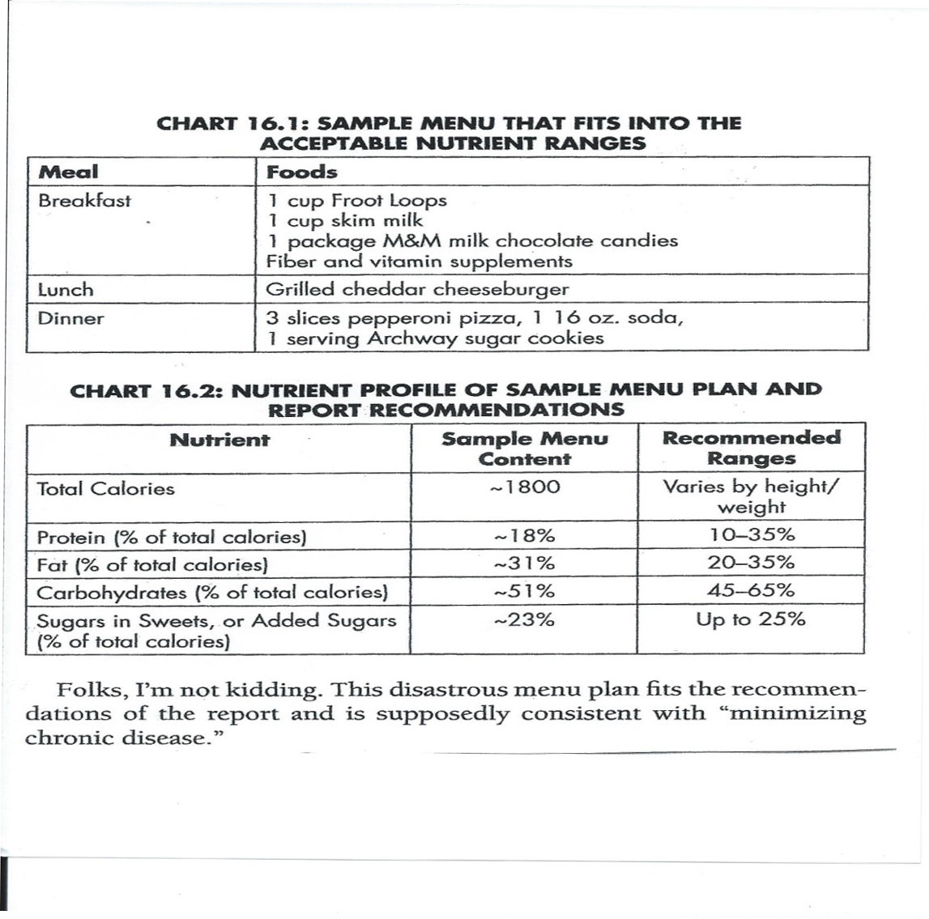

Slide 33
What is Big Medicine really protecting?
The treatment of cancers and other chronic diseases as Big Business?
The current animal-based food industries and their crony lobbyists and paid-off politicians?
The reduction of overall health care expenses assuring the economic well-being of the nation?
The prevention of increasing auto-immune diseases that tragically keep attacking more and even younger children? Producing children who have na increasing rate of contracting these diseases is a terrible consequence and risk for new families.

Slide 34
What is Big Medicine really thinking?
The American population is too stupid to understand the consequences, although it just became too obvious with the smoking habit.
The American public is too weak-willed to convert to a better life-saving diet that can eliminate most affluent diseases.

Slide 35
The Mother of All Conspiracies
Is this a conspiracy of the very few? Probably not.
The overriding desire (and fear) for conformity in all inter-connecting spheres of influence is driving this horrible conspiracy. This global contrivance is destroying the health of the American people and other affluent societies, including the so-called developing ones.

Slide 36
How did we get to a place where the healers know so little about nutrition?
Where using prescription drugs and going to hospitals is the third leading cause of death?
Where advocating a plant-based diet can jeopardize a professional career?
Where scientists spend more time mastering nature then respecting it?

Slide 37
How did we get here?
Where companies that profit from our sickness are the ones telling us how to be healthy?
Where the companies that profit from our food choices are telling us what to eat?
Where Americans are so confused about what is healthy that they no longer care?
But, let us care starting in our own homes.

Slide 38
Let’s better design our food table
Provide more and better choices for improved nutrition.
Live healthier and fight chronic diseases.
Allow the aging process to be a joyful experience of reflection and contemplation without an agonizing, disease-ridden body.

Slide 39
Slowly, but steadily, adopt a lifestyle of proper nutrition
Eat:
Whole foods.
Low-fat foods.
Plant-based foods: grains, vegetables, and fruits (reducing animal-based foods to a bare minimum).
Foods with more fiber.
Eliminate processed foods and products with GMOs and other dangerous contaminants.

